Slide 1
Introduction to K-Nearest Neighbors (KNN)

Slide 2
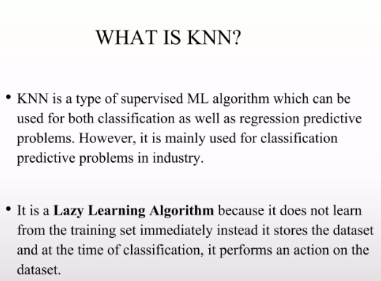

Slide 3
Why do we need a KNN algorithm?
(K-NN) algorithm is a versatile and widely used machine learning algorithm that is primarily used for its simplicity and ease of implementation. It does not require any assumptions about the underlying data distribution. It can also handle both numerical and categorical data, making it a flexible choice for various types of datasets in classification and regression tasks. It is a non-parametric method that makes predictions based on the similarity of data points in a given dataset. K-NN is less sensitive to outliers compared to other algorithms.

Slide 4
How KNN Works
1. Store the Training Data
2. Calculate the Distance: Use distance metrics (Euclidean, Manhattan, etc.) to find the closest neighbors.
3. Classify or Predict: For classification, assign the class that is most common among the neighbors; for regression, predict the average of the neighbors' values.
Illustration: Diagram showing KNN in action with data points and neighbors.

Slide 5
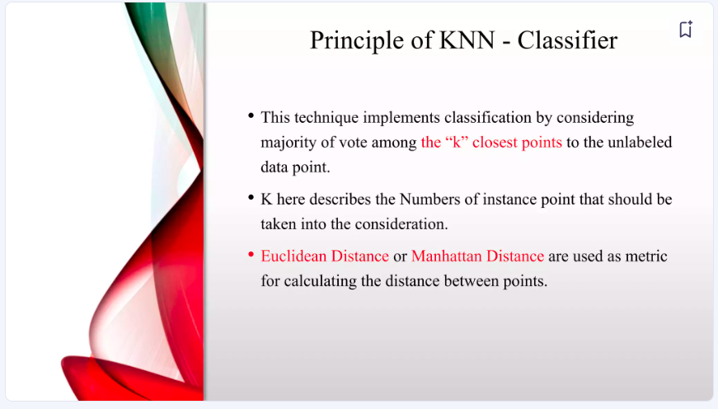

Slide 6
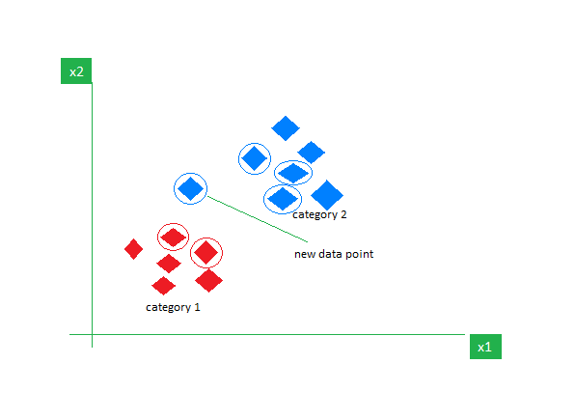

Slide 7
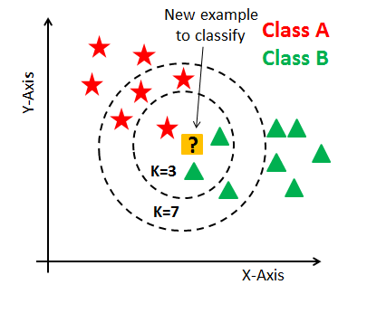

Slide 8
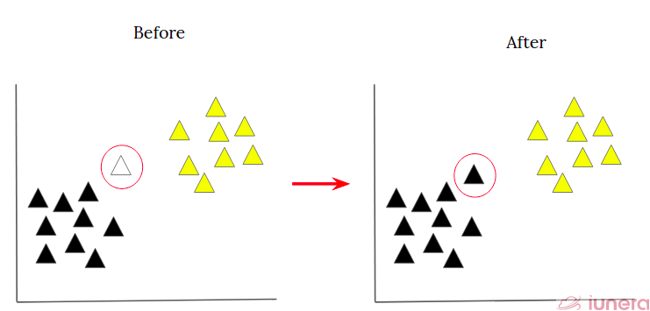

Slide 9
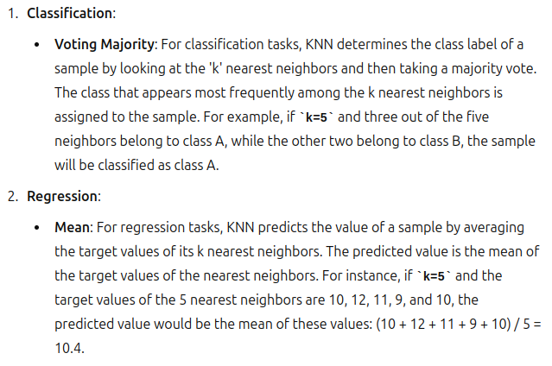

Slide 10
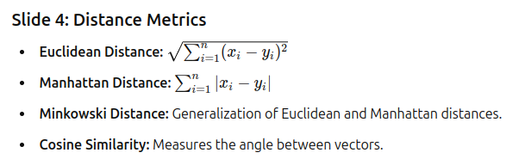
Distance Metrics

Slide 11
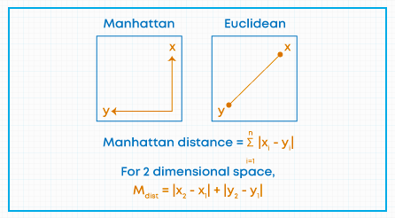

Slide 12
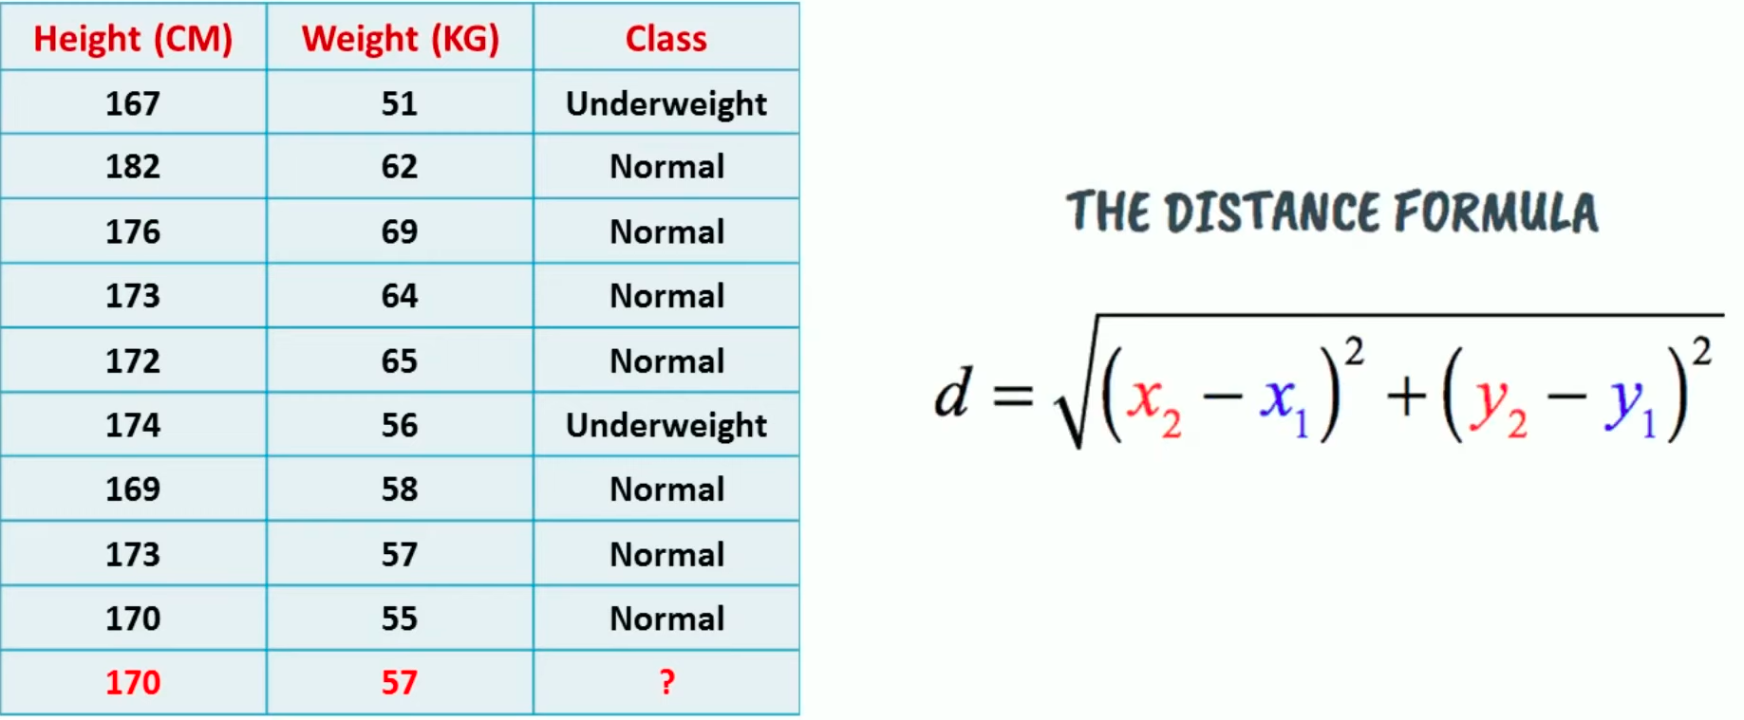

Slide 13
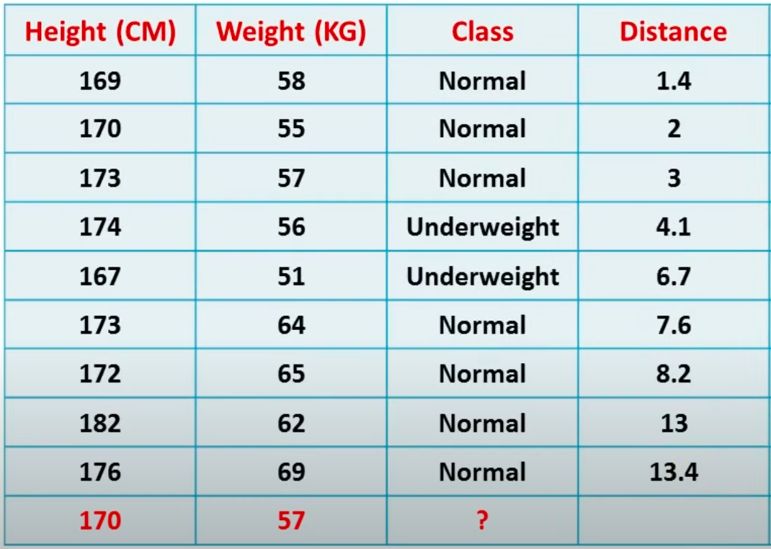

Slide 14
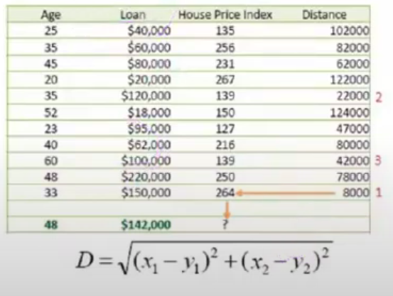

Slide 15
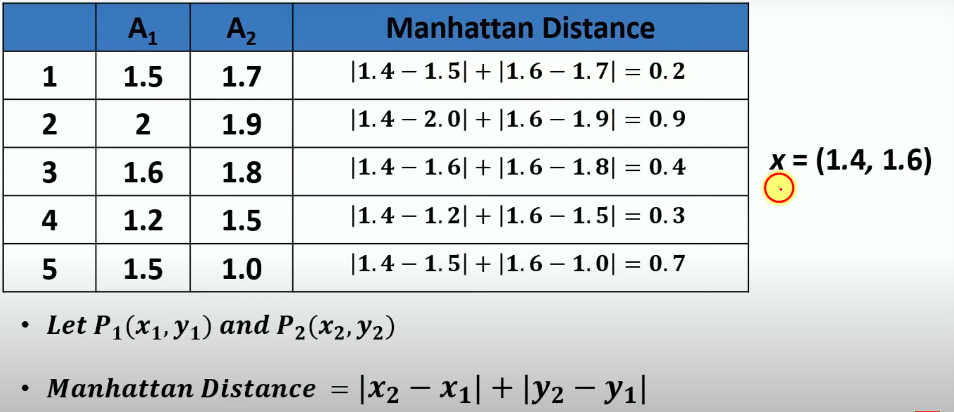

Slide 16
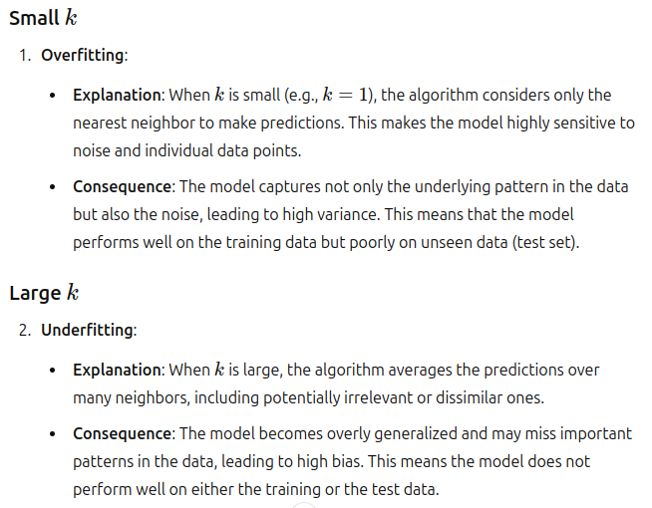
Choosing the Value of K

Slide 17
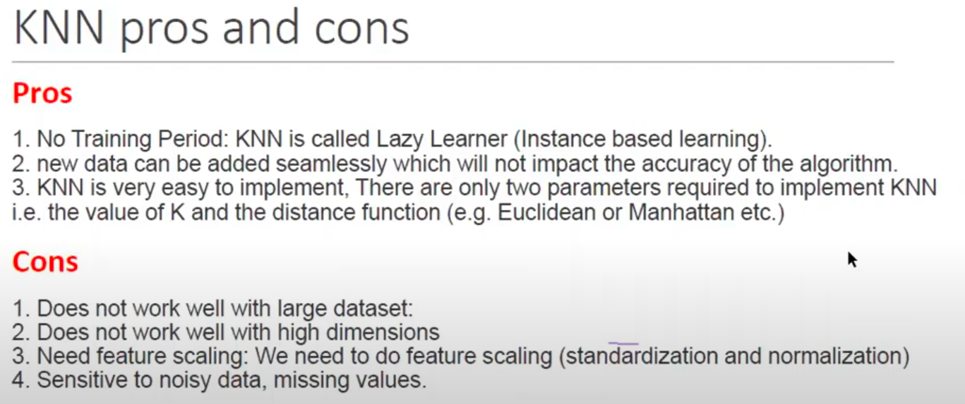
Pros and Cons

Slide 18
Applications of KNN
Classification Examples: Image recognition, spam detection, and medical diagnosis.
Regression Examples: Predicting house prices, and stock market trends.

Slide 19
Implementation
Libraries: scikit-learn in Python.
Code Example:
from sklearn.neighbors import KNeighborsClassifier
from sklearn.model_selection import train_test_split
from sklearn.datasets import load_iris
# Load dataset
data = load_iris()
X, y = data.data, data.target
# Split data
X_train, X_test, y_train, y_test = train_test_split(X, y, test_size=0.2, random_state=42)
# Initialize and train model
knn = KNeighborsClassifier(n_neighbors=3)
knn.fit(X_train, y_train)
# Predict and evaluate
y_pred = knn.predict(X_test)

Slide 20
Case Study or Example
Example: Real-world application of KNN (e.g., digit recognition using the MNIST dataset).
Results and Discussion: Show results and discuss performance.

